Slide 1

Boots to Business Module 8
Resources to Support Your Efforts
Version 5.0
Notes:
Instructor Notes:
This module is an overview of the services the SBA and its resource partners offer.
Keep in mind, many of the folks in the class may be moving somewhere else once they are out of the military. Let them know that almost identical SBA services are available wherever they may move to in the U.S. (you’ll highlight where to look for them later in the presentation
Housekeeping: As this will probably be the last class in the session, you will want to remind the attendees to fill out their end of course surveys (document that should be in their folders, titled Transition Assistance Program Entrepreneurship Track Assessment)

Slide 2
Agenda
SBA Resource Partner network
Other resources & training
B2B Follow-On Training
Next Steps
Q&A
Notes:
Instructor Notes:
You don’t need to expand on these points.
They are provided as an overview of what is to come to help focus and organize the rest of the module.

Slide 3
Veterans Business Outreach Centers
Services
One-on-One Counseling & Mentorship
Pre-Business Plan Workshops/Concept Assessments
Business Plan Assistance
Feasibility Analysis/Strategy
Training
Navigation of Local Programs & Resources
Other Related Business Development Services
https://www.sba.gov/vboc
Notes:
Instructor Notes:
We lead off the section the SBA Resource Partner network with Veterans Business Outreach Center (VBOC)s
The Veterans Business Outreach Center (VBOC) Program is designed to provide entrepreneurial/business development services, such as business training, counseling and resource partner referrals, to transitioning active duty service members, veterans, National Guard & Reserve members and military spouses who are interested in starting a small business or growing an existing business.
There are 22 VBOCs across the United States and its territories. Each VBOC has its own unique service area. VBOCs serve as the navigator to other veteran entrepreneurial development resources.
VBOC core services are provided at no cost.

Slide 4
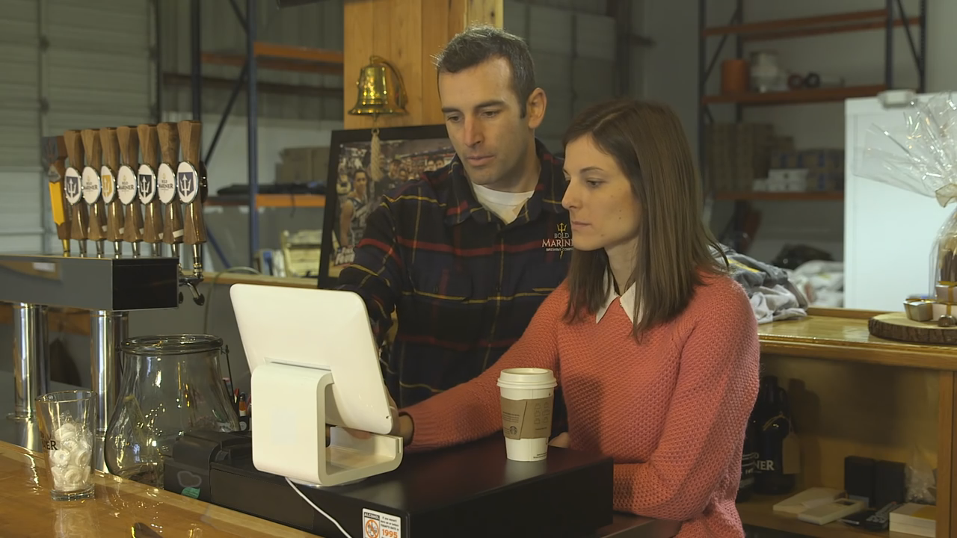
Veterans Business Outreach Centers
VBOC Client
Result:
The couple received an SBA-backed loan to help them get started
Bold Mariner Brewing Company opened their doors in 2015
Michael & Kerrie Stacks
Active-Duty sailor and spouse who wanted to start micro-brewery
Connected with local VBOC, who helped them:
Develop a business plan
Create financial projections
Apply for financing
Notes:
Instructor Notes:
This slide highlights a successful small business (Bold Mariner Brewing Company, Norfolk, VA) that got its start thanks to the assistance of a Veterans Business Outreach Center (VBOC)
Michael Stacks, Navy veteran, and his wife, Kerrie, wanted to start a micro-brewery as an homage to his father and grandfather, both home beer brewers.
As Michael was preparing to transition from the Navy, he turned to his local Veterans Business Outreach Center (VBOC) for support.
He knew starting a brewery would be a capital-intensive project and that he would need financial help to get started.
The VBOC helped him develop a business plan and financials, and also encouraged him to sign up for a Boots to Business course.
Thanks to support from the VBOC, he applied for and received an SBA-backed loan and opened Bold Mariner Brewing.

Slide 5
SCORE
Services
Mentoring
Online
In-Person
Business Tools and Templates
Workshops
Online
In-Person
https://www.score.org/
Notes:
Instructor Notes:
The SCORE Association (link is external), supported by SBA, is a nonprofit association of thousands of volunteer business counselors throughout the U.S. and its territories.
SCORE members are trained to serve as counselors, advisors and mentors to aspiring entrepreneurs and business owners. Here are some of the ways you can connect with SCORE and get free business advice:
Email a mentor: Choose a mentor online and get answers to your business questions virtually
Visit Your Local SCORE Office: Make an appointment with a mentor for in-person advice or attend a business workshop
Online Workshops: Participate in free, online workshops or register for small business webinars
E-Newsletters: Subscribe to SCORE’s e-Newsletters and get free business tips and read interviews with small business experts
More about SCORE
There are hundreds of SCORE chapters in urban, suburban and rural communities
SCORE was formed in 1964 and millions of Americans have used SCORE services
SCORE can help if you are trying to start a business or if you need help with your existing business
SCORE recently signed a Memorandum of Understanding and will be working more closely with the US Department of Agriculture

Slide 6
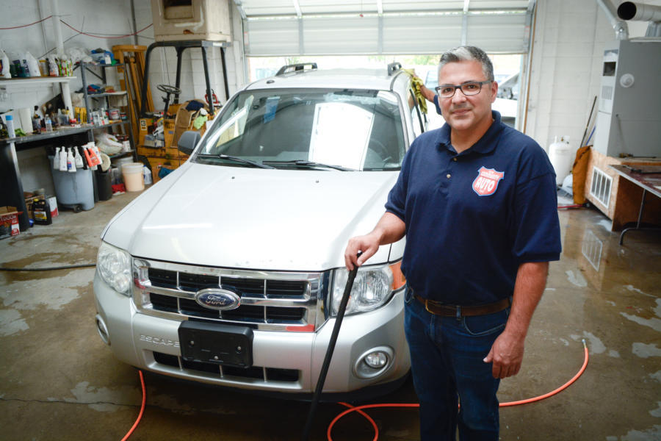

SCORE
SCORE Client
Gary Peterson
Retired Air Force Major, looking to turn a passion for automobiles into a business
Connected with local SCORE, who helped him:
Develop and scale his business idea
Attend executive level training
Build a network of business advisors
Result:
One Community Auto opened their doors in 2017
One Community Auto named a SCORE Small Business Champion
Notes:
Instructor Notes:
This slide highlights a successful small business (One Community Auto, LLC, Albuquerque, NM) that got its start thanks to the assistance of SCORE
Gary Peterson, a retired U.S. Air Force Major, turned his lifelong passion for automobiles into a business and post-service mission.
After retiring from the Air Force, Peterson attended Boots to Business (B2B) and dusted off a business idea he had temporarily put on the shelf.
The B2B course helped him put his ideas together in a comprehensive business plan.
After B2B, he developed a relationship with his local SCORE chapter where he was recommended to attend SCORE’s Emerging Leaders course.
Through this course, Gary received executive level training, where he was provided with a network and resources to build a sustainable business of size and scale.
Through the lessons he learned from SCORE and B2B, as well as other SBA resource partners, Gary opened One Community Auto which was named one of SCORE’s 2017 Small Business Champions.

Slide 7
Small Business Development Centers
Services
Business Plan Development
Manufacturing Assistance
Financial Packaging and Lending Assistance
Exporting and Importing Support
Disaster Recovery Assistance
Procurement and Contracting Aid
Market Research Assistance
https://www.sba.gov/tools/local-assistance/sbdc
Notes:
Instructor Notes:
Mission Statement
Represent the collective interest of our members by promoting, informing, supporting and continuously improving the Small Business Development Center (SBDC) network, which delivers nationwide educational assistance to strengthen small/medium business management, thereby contributing to the growth of local, state and national economies.
Vision Statement
America’s SBDC supports a well established, respected, adequately funded and capable SBDC network, recognized by public and private sector entities as the preeminent provider of small/medium business counseling, education and information. The SBDC network provides uniform, high quality, cost effective assistance through its members, resulting in a positive long-term economic impact.
WE VALUE AT ALL LEVELS OF THE SBDC NETWORK
Customer-Driven Quality and Exemplary Service
Visionary Leadership
Continuous Improvement Through Shared Learning
Member Participation and Development
Timely Response
Measurable Performance
Fact-Driven Management
Partnerships that Work
Results Orientation
Open, Honest Communication
Diversity, Integrity, Professionalism
Celebration of Excellence

Slide 8
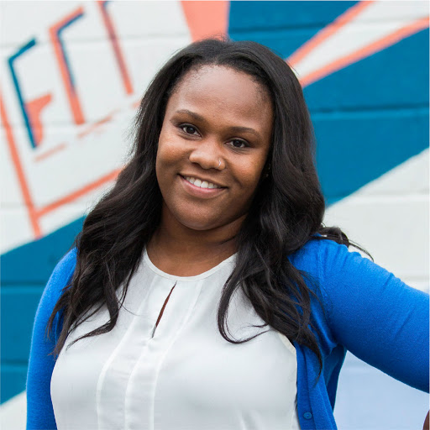

Small Business Development Centers
SBDC Client
Jilan Hall-Johnson
Military spouse looking to turn her culinary ideas into a fully-baked business
Connected with local SBDC, who helped her:
Access pre-business counseling
Put together a loan package for financing
Seek out local small business grants
Result:
Business received an SBA 7(a) loan and a grant from city of Billings, MT
Sassy Biscuit Co successfully opened and has expanded to a second location
Notes:
Instructor Notes:
This slide highlights a successful small business (The Sassy Biscuit, Co, Billings, MT) that got its start thanks to the assistance of The Small Business Development Center
Jilan Hall-Johnson is a military spouse who used her culinary experience and skills to turn her bruncherie idea into a fully baked business.
After her husband was stationed in Billings, MT as a member of the U.S. Marine Corps, she was on the hunt for new employment opportunities in the area.
Options were limited and Jilan knew she had a great idea and the passion to start her own business, but she wasn’t sure how to execute her plan.
She turned to her local Small Business Development Center (SBDC) at Big Sky Economic Development. The SBDC gave Jilan counseling assistance, helped her register for Boots to Business Reboot, and worked with her on financial projects to help her put together a loan package.
Jilan applied for and received SBA 7(a) financing for $290,000.
The SBDC also helped Jilan apply for a local grant package that helped her receive over $13,000 in grant funding to help with leasehold improvements to her restaurant.
Thanks to support from the SBDC, Jilan successfully opened the Sassy Biscuit Co. in Billings, MT and recently opened a second location in Dover, NH.

Slide 9
Women’s Business Centers
Services
Training
Counseling
Access to Capital
Webinars
Organizational development tools
Fund-raising assistance
Best practices in program delivery
https://www.sba.gov/tools/local-assistance/wbc
Notes:
Instructor Notes:
Women's Business Centers (WBCs) represent a national network of nearly 100 educational centers throughout the United States and its territories, which are designed to assist women in starting and growing small businesses. WBCs seek to "level the playing field" for women entrepreneurs, who still face unique obstacles in the business world.
SBA’s Office of Women’s Business Ownership (OWBO) oversees the WBC network, which provides entrepreneurs (especially women who are economically or socially disadvantaged) comprehensive training and counseling on a variety of topics in several languages.
Office of Women's Business Ownership - Mission Statement
The Office of Women’s Business Ownership’s mission is to enable and empower women entrepreneurs through advocacy, outreach, education and support. Through the management and technical assistance provided by the WBCs, entrepreneurs, especially women who are economically or socially disadvantaged, are offered comprehensive training and counseling on a vast array of topics in many languages to help them start and grow their own businesses.

Slide 10
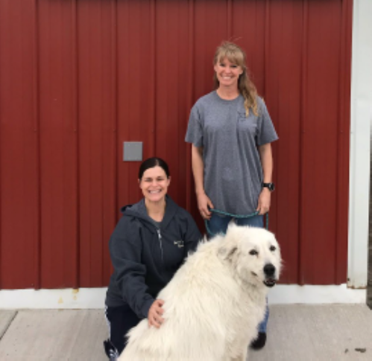

Women’s Business Centers
WBC Clients
Lila Teunissen & Michelle Thomsen
Current and former National Guard members realized service members needed quality dog boarding while deployed or drilling
Connected with local WBC, who helped them:
With pre-business counseling
Get designated as a Women-Owned Business
Connect with other small business resources
Result:
The Bed N’ Biscuit Ranch is open & helping dogs and owners live their best lives
Notes:
Instructor Notes:
This slide highlights a successful small business (The Bed N’ Biscuit Ranch, Bismarck, ND) that got its start thanks to the assistance of a Women’s Business Center
Lila Teunissen, formerly employed by the North Dakota National Guard, and Michelle Thomsen, a current North Dakota National Guard, came to their dream of business ownership from different directions, but they found common ground in one major area – a love of dogs.
They saw a need for quality dog boarding services for fellow service members while they deployed or went to drill.
To help start their business, Lila and Michelle turned to their local Women’s Business Center (WBC) for counseling and help achieving their Women-Owned Business Designation.
The WBC also referred the duo to their local Veterans Business Outreach Center for additional assistance.
From there, Bed N’ Biscuit Ranch was born.

Slide 11
Other Resources and Training
U.S. Department of Agriculture
B2B Follow-on Training
B2B Revenue Readiness
Things you can do now
Notes:
Instructor Notes:
Straight forward slide. No need to get into too much detail. You’ll have details on the items listed in the upcoming section.

Slide 12
Other Resources to Consider
APEX Accelerators
Formerly Procurement Technical Assistance Centers (PTACs)
SBA Export Assistance
SBA Surety Bond Program
Small Business Innovation Research (SBIR) Small Business Technology Transfer (STTR) Programs
SBA Office of Advocacy
Notes:
Instructor Notes:
APEX Accelerators (formerly Procurement Technical Assistance Centers PTACs]) provide local, in-person counseling and training services to small businesses that want to sell products and services to federal, state, and/or local governments (aka do Government Contracting. Note: They do not help companies START their businesses. They only work with existing businesses that are ready to do business with the government.
SBA Export Assistance - Nearly 96 percent of consumers live outside the U.S., and two-thirds of the world’s purchasing power is in foreign countries
U.S. Export Assistance Centers (USEACs) and SBDCs are staffed with professionals that can assist businesses that want to sell their products and services overseas.
Services include help finding international buyers, export finance programs and more.
SBA Surety Bond Program - Surety bonds help small businesses win contracts by providing the customer with a guarantee that the work will be completed. Many public and private contracts require surety bonds, which are offered by surety companies. The SBA guarantees surety bonds for certain surety companies, which allows the companies to offer surety bonds to small businesses that might not meet the criteria for other sureties.
Small Business Innovation Research (SBIR) Small Business Technology Transfer (STTR) Programs - The SBIR and STTR programs encourage domestic small businesses to engage in Federal Research/Research and Development (R/R&D) with the potential for commercialization. The mission of the SBIR/STTR programs is to support scientific excellence and technological innovation through the investment of Federal research funds in critical American priorities to build a strong national economy.
SBA Office of Advocacy - The Office of Advocacy is the independent voice for small business within the federal government, by participating in the regulatory reform process and conducting outreach with small businesses to ensure SBA provides effective representation of small business viewpoints. The office also publishes a host of research studies on small business finance, demographics, income and other topics. Note: These advocacy reports might be of particular use to the presenters and/or the attendees
Veteran-Owned Businesses And Their Owners: Data From The U.S. Census Bureau’s Survey Of Business Owners
Small Business Facts: Spotlight On Veteran-Owned Employer Businesses

Slide 13





USDA Rural Development
Over 40 programs to help rural America
Business and Cooperative
Business Loans
Technical Assistance Grants
Renewable Energy
Housing
Single Family Housing
Multi-Family Housing
Community Facilities
Public Services
Healthcare
Education
Rural Utilities
Water and Sewer
Broadband
Electric and Telephone
www.rd.usda.gov
Notes:
Instructor Notes:
USDA supports Veterans looking to build or grow a small business in rural America.
USDA does this through Loans and Loan Guarantees; Process and Marketing of Products; and Energy Efficiency Improvements.
The next few slides will go into a little more detail on these three areas

Slide 14
USDA Business Programs
Business and Industry Loan Guarantees
Eligible: Rural Businesses
How can guaranteed loan funds be used?
Examples of eligible uses include:
• Business development, growth, modernization, conversion, or repair
• Buy and develop land, buildings, and associated infrastructure for commercial or industrial use
• Buy and install machinery, equipment, supplies, and inventory
• Refinance debt to create cash flow and create jobs
• Acquire businesses or industries when the loan will maintain operations, and create or save jobs
https://www.rd.usda.gov/programs-services/business-programs/business-industry-loan-guarantees
Rural Energy for America Program
Eligible: Rural Small Businesses and Agriculture Producers
Grants up to 40% of Eligible Project Costs
Guaranteed Loans up to 75% of Eligible Project Costs
How can funds be used?
Example of Renewable energy systems:
Biomass
Geothermal
Wind and/or solar Generation
Examples of Energy Efficiency:
High Efficiency HVCA
Insulation / lighting
Replacement to high energy efficient equipment
https://www.rd.usda.gov/programs-services/energy-programs/rural-energy-america-program-renewable-energy-systems-energy-efficiency-improvement-guaranteed-loans
Rural Microentrepreneur Assistance Program
Eligible: Rural Small Business with 10 or fewer full-time employees
Maximum loan amount - $50,000
Fixed Interest Rate
Limited to 75% of project costs
How can funds be used?
Examples of eligible uses include:
Working capital
Debt refinancing
Purchase equipment and supplies
Improve real estate
https://www.rd.usda.gov/programs-services/business-programs/rural-microentrepreneur-assistance-program
USDA is
OPEN for
Business
Notes:
Instructor Notes:
Loans and Loan Guarantees
USDA can help bolster the availability of private credit by guaranteeing loans for rural businesses.
In some cases, the borrower’s headquarters may be based within a larger city as long as the project is located in an eligible rural area
Funds can be used for business acquisition or conversion; the purchase and development of land, buildings, or facilities; and the purchase of equipment, machinery, or supplies; among other things.

Slide 15
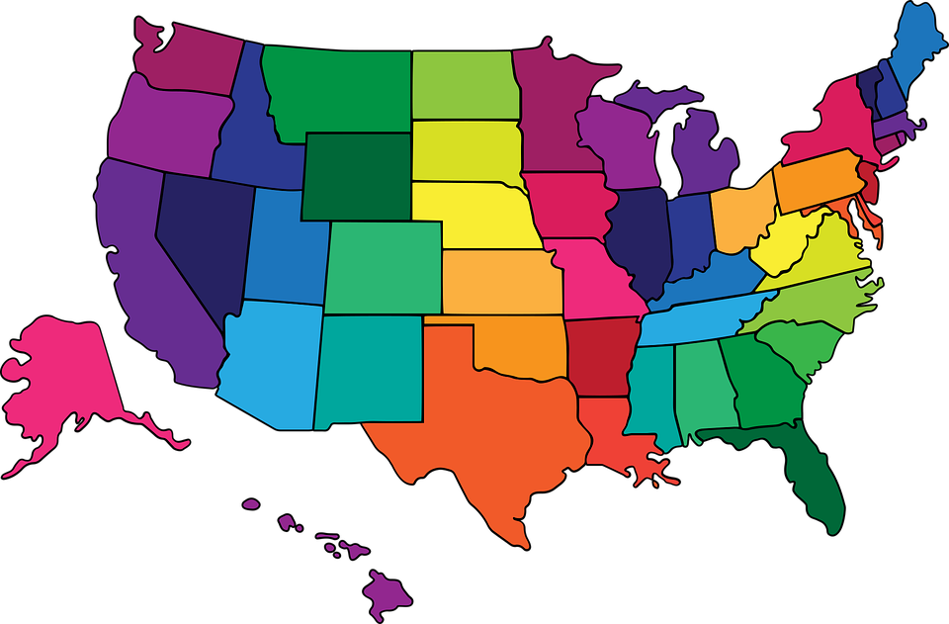
To learn more about these programs and others, Contact Your State USDA Office
USDA is
OPEN for
Business
https://www.rd.usda.gov/about-rd/state-offices
Notes:
Instructor Notes:
Loans and Loan Guarantees
USDA can help bolster the availability of private credit by guaranteeing loans for rural businesses.
In some cases, the borrower’s headquarters may be based within a larger city as long as the project is located in an eligible rural area
Funds can be used for business acquisition or conversion; the purchase and development of land, buildings, or facilities; and the purchase of equipment, machinery, or supplies; among other things.

Slide 16

Next Step: Boots to Business Online Follow-on Training?
B2B Revenue Readiness (B2B RR)
Six-week virtual training program designed to help participants take a business idea from concept to actionable plan in a short timeframe
Focused on:
Identifying & understanding customers
Developing a business model
Drafting a business plan
Upon conclusion, B2B RR staff connect participants with appropriate veteran-focused small business mentors
For more information, or to enroll:
Visit the B2B Portal at https://sba.my.site.com/
Notes:
Instructor Notes:
Boots to Business and Reboot grads have the option of further study through the free Boots to Business Revenue Readiness Business Model to Business Plan course taught by our grant partners at Mississippi State University.
This course is a Lean (compressed) approach to developing your Business Plan.
Over a six week period of interactive virtual classroom instruction, you will develop and refine your Business Model into a Business Plan.
All of this will be accomplished with constant feedback from an instructor team of successful small business owners.
As with the Boots to Business (B2B) and Boots to Business Reboot introduction courses, there is no cost to the eligible veteran or spouse for enrolling in this course.
For a list of upcoming courses or to register, visit https://sba.my.site.com/s/rr-msu-course-information

Slide 17

Next Step: Keep it Moving…
Connect with one of SBA’s local Resource Partners
https://www.sba.gov/local-assistance
Start working on your business plan
Continue researching your business opportunity
Sign up for free follow-on training
https://sba.my.site.com/
https://www.sba.gov/sba-learning-platform
Notes:
Instructor Notes:
It’s important that those attendees that are still interested in business ownership continue to prepare for the day that they get started.
Why not “now?”
Some of the options available include:
Connecting with an SBA resource partner(s) (there are more than 10,000 locations throughout the U.S. and territories)
Work on their business plan
There are numerous SBA resource partners that can help, as well as the B2B follow-on courses or BP courses in the SBA learning center
Continue to research and study up on the types of business that they are interested in opening
Continue learning by signing up for B2B follow-on courses, or courses through the SBA Learning Center

Slide 18
Questions & Discussion
Notes:
Q&A / Discussion Starters:
The below questions (or other questions you may choose to use instead) are provided to either ask in question form or use to start a dialogue, and are meant to help check for understanding and emphasize key information from the module they have just completed.
Question 1: Name the SBA resource partners available to help you start or grow your business?
Answer 1:
(The four discussed are below. The class may not be able to remember them all….)
Veteran Business Outreach Centers (VBOCs)
Small Business Development Centers (SBDCs)
Women’s Business Centers (WBCs)
SCORE
Question 2: What agencies did we talk about in this module that have government-backed loan programs to help small businesses start, grow or expand?
Answer 2: The US Small Business Administration (SBA) and US Department of Agriculture (USDA)
Answer any questions the group may have or if there are topics they’d like to discuss. Afterward have them finish filling out their Business Model Canvas. For this section, have them continue to add to the Key Partners and Key Resources sections of their Business Model Canvas (Page XX & XX in the Printed workbook, page XX in the Virtual workbook).

